Slide 1
Investigating a Project & Picking a Function to Fuzz

Slide 2
Start with a Simple Project
Fuzz driver difficulty is determined by more than the rated difficulty!
Difficulty Factors:
Existing Drivers: simple, medium, complex
Low LOC counts
Fast Compile Times
Low or Mid-Range Static Code Coverage (more uncovered code)
Any project you are personally familiar with!

Slide 3
Picking a Function to Fuzz
Important Criteria:
Must make sense to fuzz: understand what the function does!
Must be on an attack surface: processes untrusted input
Must tolerate any type of input: not exit or crash
Control dependencies: know sequence of functions is executed
Date dependencies: understand normal input to its parameters

Slide 4
Fuzz Driver Creation Process
Target Identification
Read Training Description
Google the project name
Search for API details, unit tests, interfaces
Study Existing Fuzz Drivers
Program Analysis
Function Selection
Identify required input values
Identify functional dependencies
Control-Flow Analysis
Data-Flow Analysis
Fuzz Driver Creation

Slide 5
Good Fuzz Driver Development Methodology
A good harness achieves both high code coverage and a high rate of bug identification.
To achieve this, you need:
Understand the CodeBase of the target code
Optimize for code coverage, cyclomatic complexity
Deterministic Behavior (No multithreading, no random)
Avoid Intentional Crashes

Slide 6
New Fuzz Driver or Expand Existing Driver?
New Fuzz Driver:
Untouched code
Unfuzzed interface
Large codebases with complex functions / dependencies
Expand Existing Fuzz Driver:
Fix blocked code (explore the Fuzz Introspector report)
Minor improvements
Smaller codebases calling multiple simple functions

Slide 7
Improving Your Fuzz Driver [1/3]
Checklist:
Run a fuzz introspector report and view the call tree, looking at unreached sections, and determine why these areas are not being hit.
Vary the structure and constraints on your input data. Are many runs failing early due to invalid data types?
Could different parameter combinations hit code not currently being reached?
Examine the functions being called. Could you call functions higher on the call tree to reach more code?
Experiment with different sanitizers and check for hidden errors, revealed by fuzzing runs with address, undefined, thread, and memory sanitizers.

Slide 8
Improving Your Fuzz Driver [2/3]
Checklist:
Are you using a seed corpus? Can you make this corpus more diverse and also remove redundant samples?
Could implementing additional preconditions be necessary to fulfill control dependencies needed for untouched code? I.E., do you need to open a file before you can read from it?
Look for complex branch conditions involving checksums, hashes, or magic values. Could you add custom comparators to your fuzz driver, or bypass these checks by calling functions beyond them?
Are timeouts or memory errors occurring when running your fuzz driver?

Slide 9
Improving Your Fuzz Driver [3/3]
Checklist:
Can you improve performance by testing and optimizing your code?
Do you see the need to extend your fuzz driver by calling additional functions or by creating a different new fuzz driver entirely?

Slide 10
Other Tricks
Search GitHub or blog posts for different projects with a similar theme or structure and adopt their fuzz drivers for your project
Search existing OSS-Fuzz drivers:
https://github.com/search?q=repo%3Agoogle%2Foss-fuzz+path%3A%2F%5Eprojects%5C%2F%2F++AND+%28language%3AC%2B%2B+OR+language%3AC%29&type=code

Slide 11
More Time-Saving Tricks
Tweaking code and then regenerating coverage reports can be slow.
Compiling and then running your fuzz driver is much faster.
Put Fuzzer into debugging mode, watch output
Add print statements into the source code
Create intentional crashes into the source code (Example: null pointer dereference)
The project source code is always available in the Fuzz Platform under “Workspace”, or in the shell under /src-{sanitizer}

Slide 12
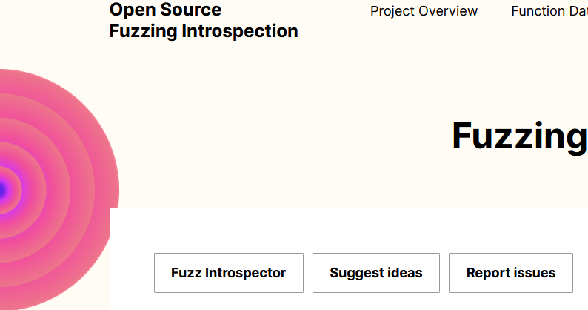
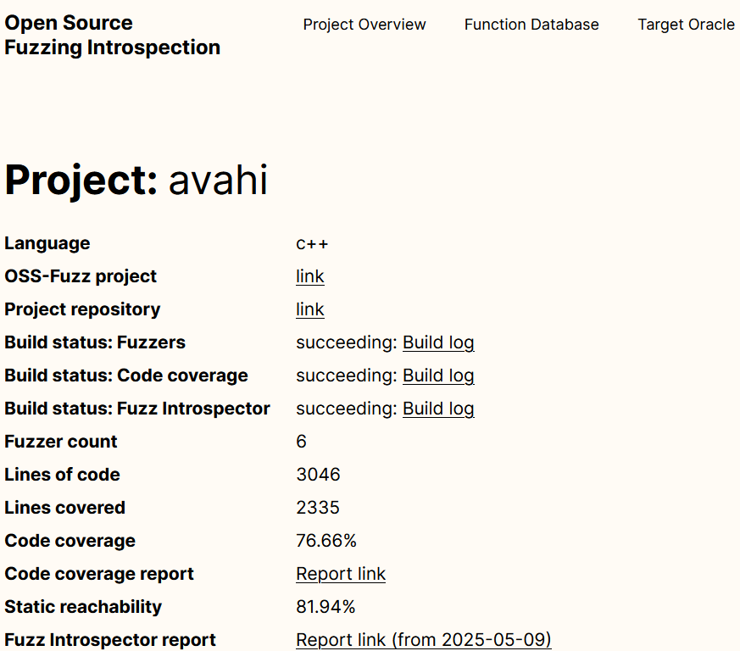
Online Reports
Browse code online on:
https://introspector.oss-fuzz.com/projects-overview
Github repository links
Project statistics
Code coverage of existing fuzz drivers
Browse source code coverage reports

Slide 13
Fuzz Introspector
Static analysis tools are useful to analyze source code complexity, function parameters, and finding functions high in the call tree to fuzz
Fuzz Introspector reports can be generated manually or viewed online
Evaluate the effectiveness of existing fuzz drivers or test new ones
Troubleshoot sections of code the fuzz driver fails to reach
List possible functions with high reach/complexity to create a new fuzz driver

